Slide 1

What is Operations in the Falkland Islands
By: Cabot Steward

Slide 2
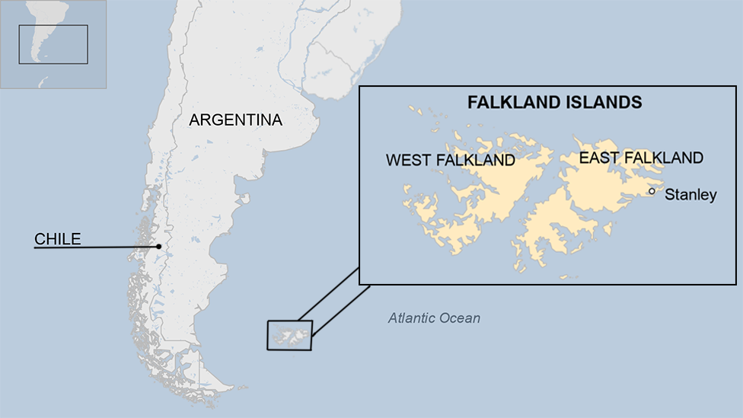
Falkland Island Background
18th century – Spanish & British
1833 - Britain took control from Argentina
World War II – Strategic Location
1982 - Falkland Island War
Source - https://www.bbc.com/news/world-latin-america-18425572
Notes:
18th century was disputed between Spain and Britain
1833 Britain took control from Argentina (Argentina was the owner after declaring independence from Spain in 1816)
World War II – Strategic location islands, pearl harbor or guam
1982 – Falkland Island War – War between Argentina and Britain over control.
Modern Day –
Argentina still claims the islands but Britain occupies it.
Picture - https://www.bbc.com/news/world-latin-america-18425572

Slide 3
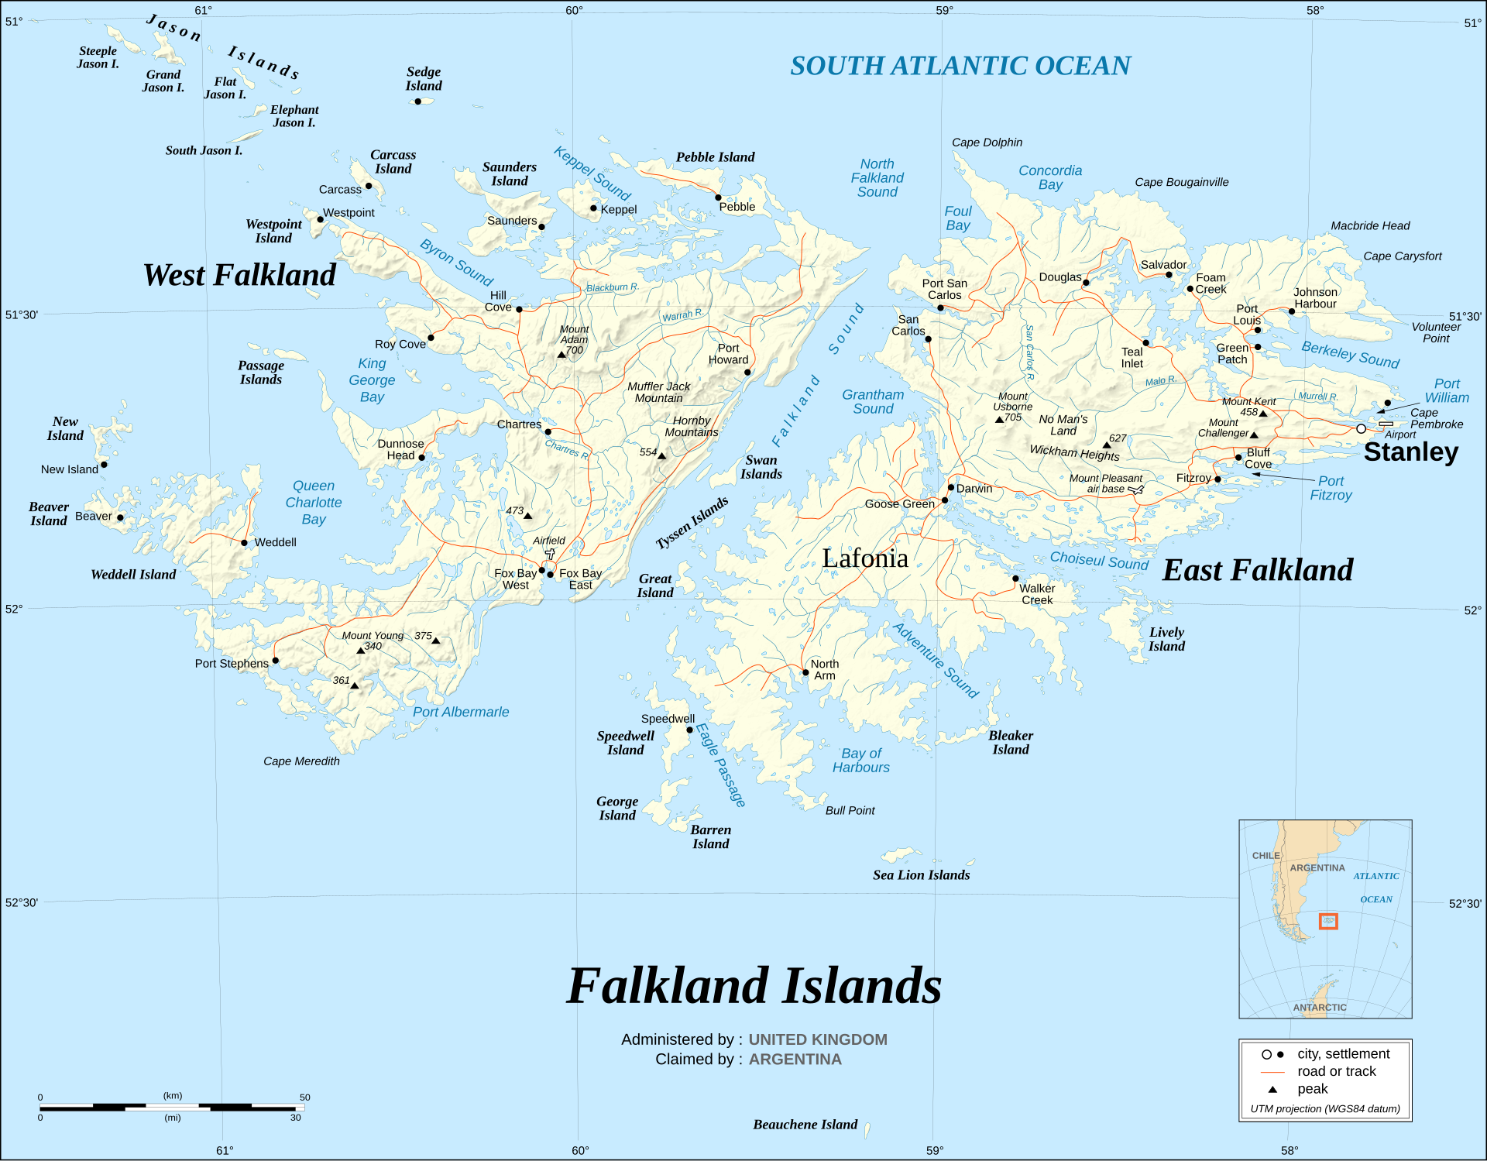
Geography Constraints
Falkland Islands Tourism, https://www.falklandislands.com/plan-your-trip/getting-here#:~:text=All%20flights%20arrive%20at%20Mount,the%20UK%20Ministry%20of%20Defence. Accessed 30 Jan. 2025.
Notes:
40 different cruise ships operate
Capital Stanley – Main airport mount pleasant
Lots of flights
Source: . Falkland Islands Tourism, https://www.falklandislands.com/plan-your-trip/getting-here#:~:text=All%20flights%20arrive%20at%20Mount,the%20UK%20Ministry%20of%20Defence. Accessed 30 Jan. 2025.

Slide 4
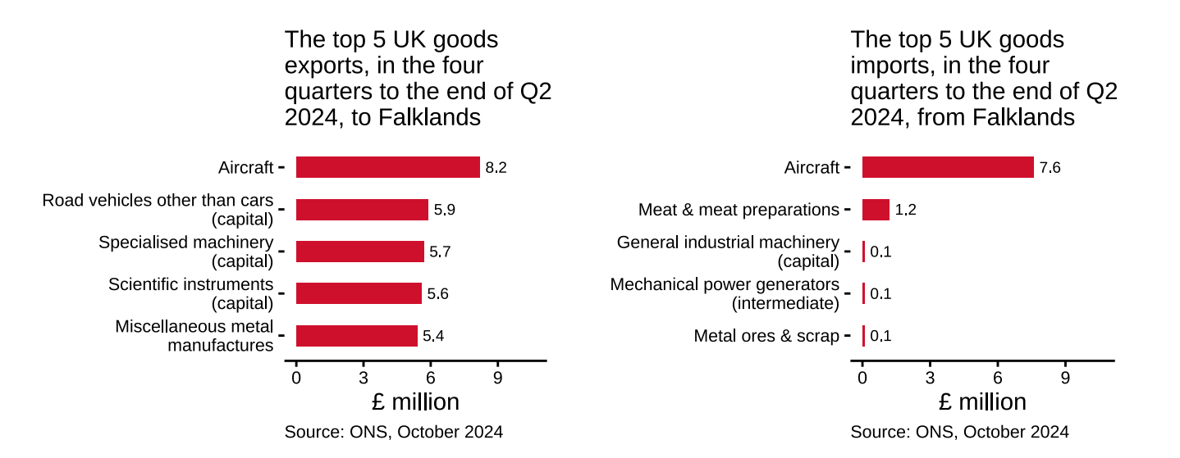
What creates the operations?
Source: UK Government. Falkland Islands Trade and Investment Factsheet. 20 Dec. 2024,www.assets.publishing.service.gov.uk/media/6762ce74ff2c870561bde7b2/falkland-islands-trade-and-investment-factsheet-2024-12-20.pdf. Accessed 29 Jan. 2025
Notes:
Oil Exploration
Shipping Trade
Travel (lots of travel)
Fishing and meat packing
Source: UK Government. Falkland Islands Trade and Investment Factsheet. 20 Dec. 2024,
www.assets.publishing.service.gov.uk/media/6762ce74ff2c870561bde7b2/falkland-islands-trade-and-investment-factsheet-2024-12-20.pdf. Accessed 29 Jan. 2025

Slide 5

Brexit
Source: "Falkland Islands: The Impact of Brexit on the Islands' Economy." UK Parliament, 2021, committees.parliament.uk/publications/4486/documents/45132/default. Accessed 29 Jan. 2025.
Notes:
Due to Brexit, there is a tariff of between six and 18 percent on fish and 42 percent on meat exports to the EU. This highlights how their operations can be affected by an outside force such as leaving the EU.
The fishing industry makes up 50 percent of their entire GDP meanwhile it also makes up 60 percent of government revenue
Source: "Falkland Islands: The Impact of Brexit on the Islands' Economy." UK Parliament, 2021, committees.parliament.uk/publications/4486/documents/45132/default. Accessed 29 Jan. 2025.

Slide 6
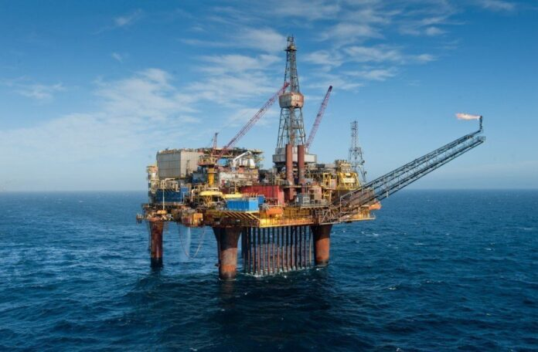
Liquid Gold
"The Falkland Islands Announce the Start of Oil Exploration in Marine Areas." Agenzia Nova, 30 Jan. 2025, https://www.agenzianova.com/en/news/The-Falkland-Islands-announce-the-start-of-oil-exploration-in-marine-areas/. Accessed 30 Jan. 2025.
Notes:
Post 1982 the Falkland Islands began to independently auction the exploration licenses. This in turn increased tensions with Argentina as they felt this violated their sovereignty.
They sit on significant oil reserves
Sources: "Oil and the Falklands/Malvinas: Oil Companies, Governments, and the Politics of Resource Extraction." The Round Table: The Commonwealth Journal of International Affairs, vol. 111, no. 2, 2022, pp. 203-220. Taylor & Francis, https://doi.org/10.1080/00358533.2022.2037235.
"The Falkland Islands Announce the Start of Oil Exploration in Marine Areas." Agenzia Nova, 30 Jan. 2025, https://www.agenzianova.com/en/news/The-Falkland-Islands-announce-the-start-of-oil-exploration-in-marine-areas/. Accessed 30 Jan. 2025.

Slide 7
Falkland Islands Maritime Authority – FIMA
Shipping safety and regulations
Environmental protections
Maritime Law Enforcement
Port and Navigation Services
Search and Rescue

Slide 8
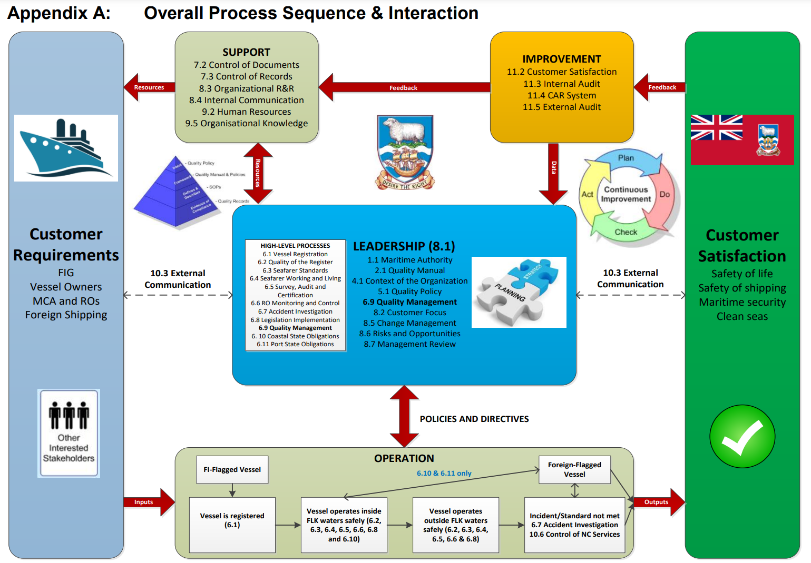
FIMA Operations
Falkland Islands Maritime Authority. Quality Management System Manual. Falkland Islands Government, rev. 0, www.falklands.gov.fk/maritimeauthority/images/2.1_Quality_Manual_rev_0.pdf.

Slide 9
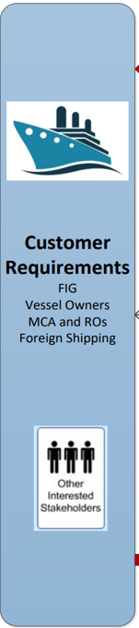
Customer Requirements
Work with stakeholders
Ensure compliance
Falkland Islands Maritime Authority. Quality Management System Manual. Falkland Islands Government, rev. 0, www.falklands.gov.fk/maritimeauthority/images/2.1_Quality_Manual_rev_0.pdf.
Notes:
Stakeholders - Falkland Islands Government (FIG), vessel owners, and other shipping entities.
Compliance – Ensure all maritime operations are within rules established and set by these stakeholders.

Slide 10
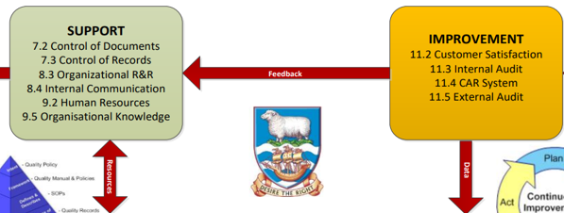
Support and Improvement
Falkland Islands Maritime Authority. Quality Management System Manual. Falkland Islands Government, rev. 0, www.falklands.gov.fk/maritimeauthority/images/2.1_Quality_Manual_rev_0.pdf.
Notes:
Management of documents, employee training, ensuring smooth communication
Regular audit system, feedback loop, customer satisfaction

Slide 11
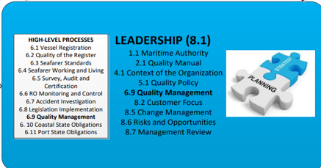
Leadership
Clear strategy
Create Processes
Enforce Policies
Customer Focus
Falkland Islands Maritime Authority. Quality Management System Manual. Falkland Islands Government, rev. 0, www.falklands.gov.fk/maritimeauthority/images/2.1_Quality_Manual_rev_0.pdf.
Notes:
Strategy – ensure leaders have a clear strategy through a quality manual that is customer focused
Oversight – enforce policies, identify areas to improve mission and customer satisfaction

Slide 12
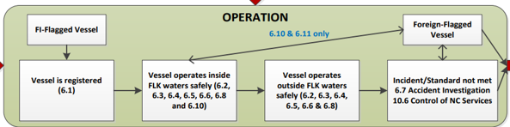
Operation
Safety Standards
Inspections
Accident Investigation
Search and Rescue
Falkland Islands Maritime Authority. Quality Management System Manual. Falkland Islands Government, rev. 0, www.falklands.gov.fk/maritimeauthority/images/2.1_Quality_Manual_rev_0.pdf.
Notes:
Ensure safety standards are met
Accident investigation for both environmental and others

Slide 13
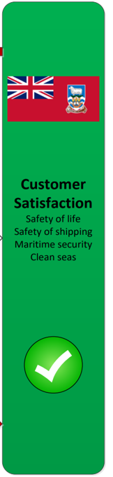
Customer Satisfaction
Safety of Life
Safety of Shipping
Maritime Security
Clean Seas
Falkland Islands Maritime Authority. Quality Management System Manual. Falkland Islands Government, rev. 0, www.falklands.gov.fk/maritimeauthority/images/2.1_Quality_Manual_rev_0.pdf.
Notes:
Focus on safety, of shipping, life and security and clean seas

Slide 14
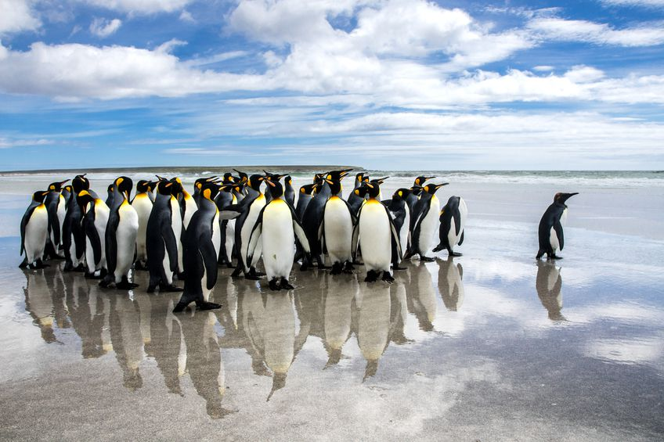
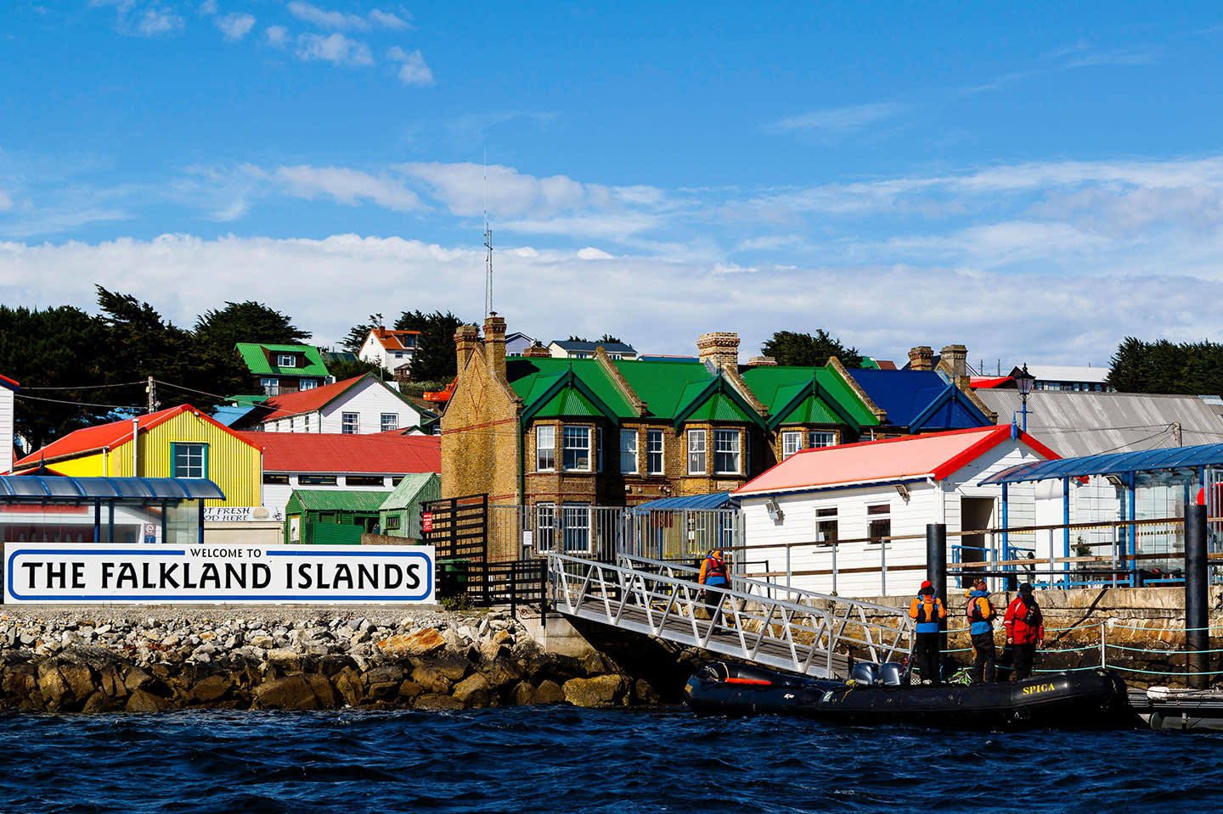
"Falkland Islands Tourism: Unmissable Wildlife on the Islands." Australis, 30 Jan. 2025, https://blogpatagoniaqa.australis.com/falkland-islands-tourism-unmissable-wildlife-islands/. Accessed 30 Jan. 2025.
"How to Visit the Falkland Islands." Quark Expeditions, 30 Jan. 2025, https://www.quarkexpeditions.com/blog/how-to-visit-the-falkland-islands. Accessed 30 Jan. 2025.
Notes:
"Falkland Islands Tourism: Unmissable Wildlife on the Islands." Australis, 30 Jan. 2025, https://blogpatagoniaqa.australis.com/falkland-islands-tourism-unmissable-wildlife-islands/. Accessed 30 Jan. 2025.
"How to Visit the Falkland Islands." Quark Expeditions, 30 Jan. 2025, https://www.quarkexpeditions.com/blog/how-to-visit-the-falkland-islands. Accessed 30 Jan. 2025.

